Slide 1
Sample Superstore Dashboard
File created on: 2/2/2024 2:50:14 PM

Slide 2
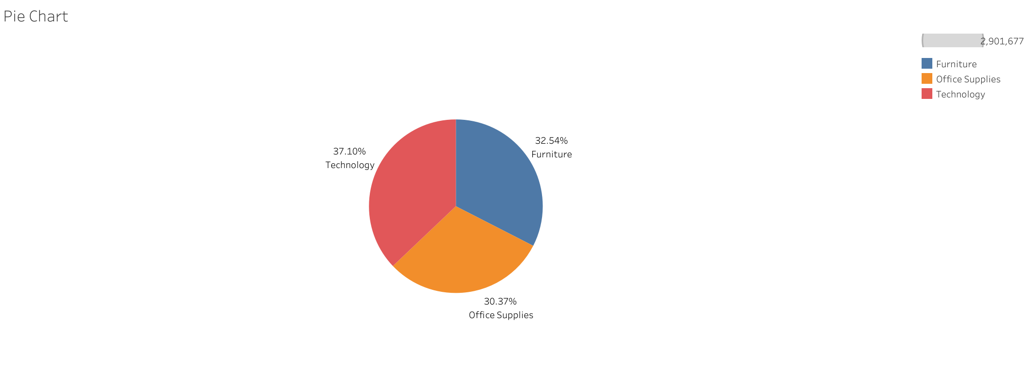

Slide 3
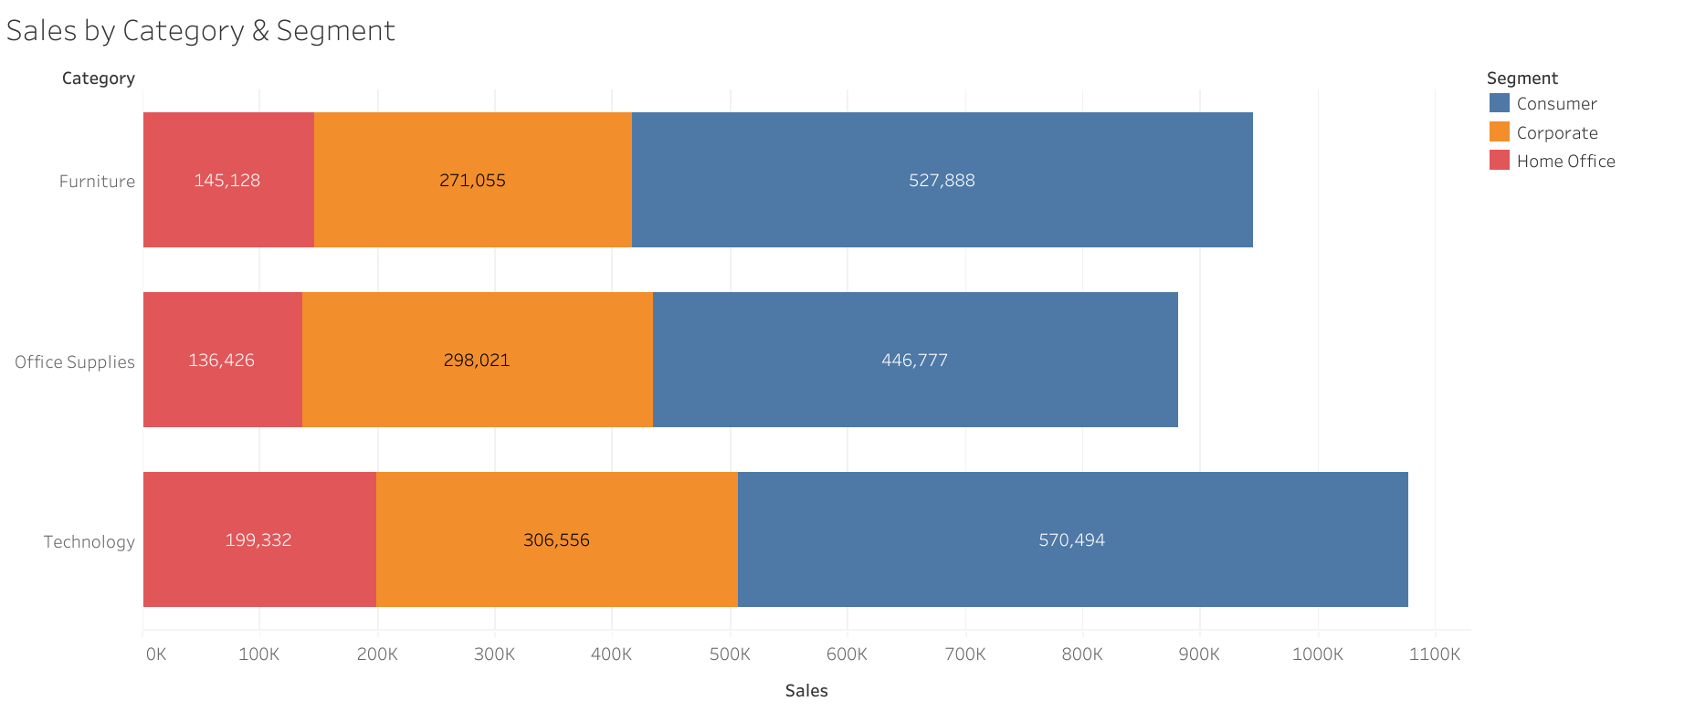

Slide 4
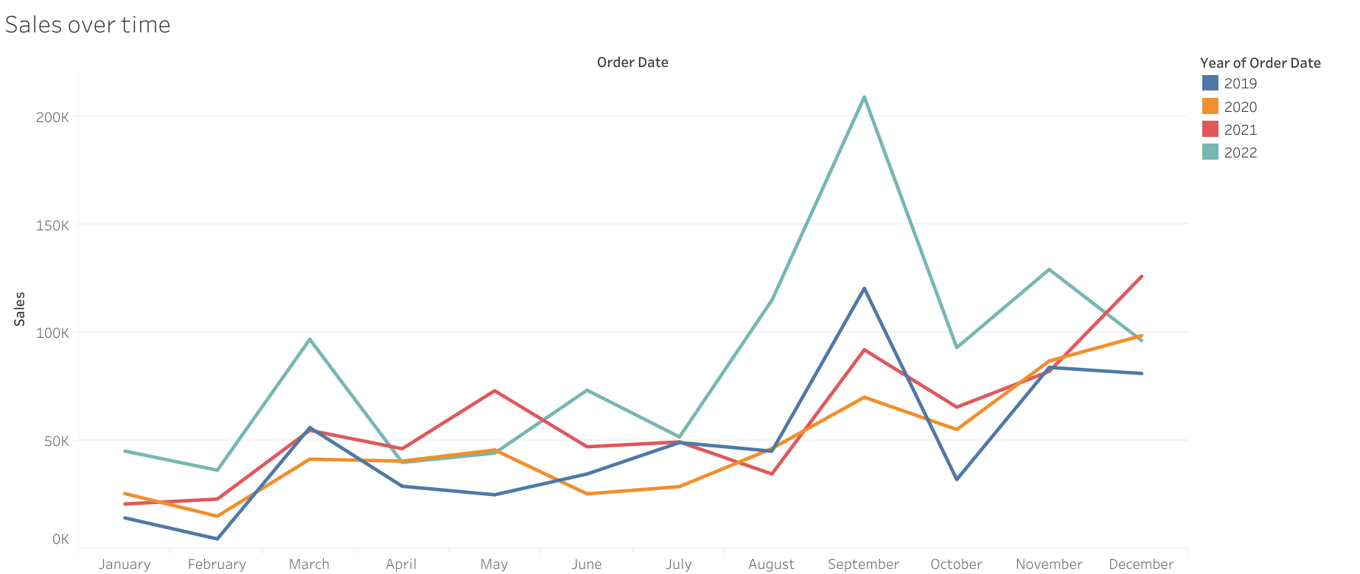

Slide 5
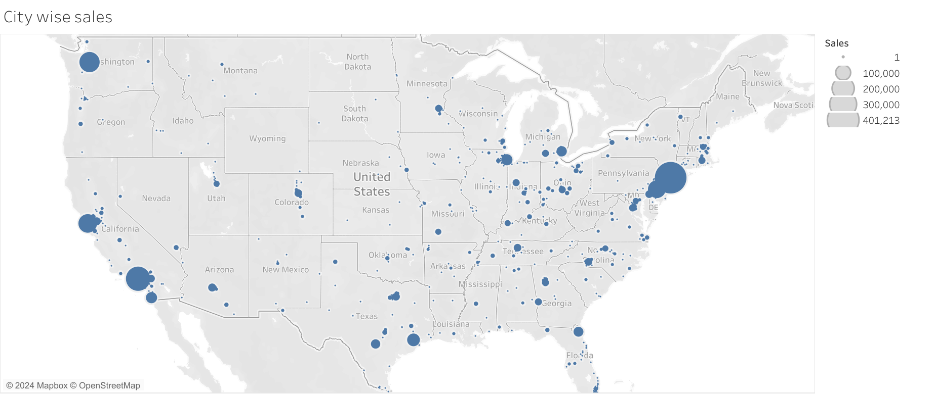

Slide 6
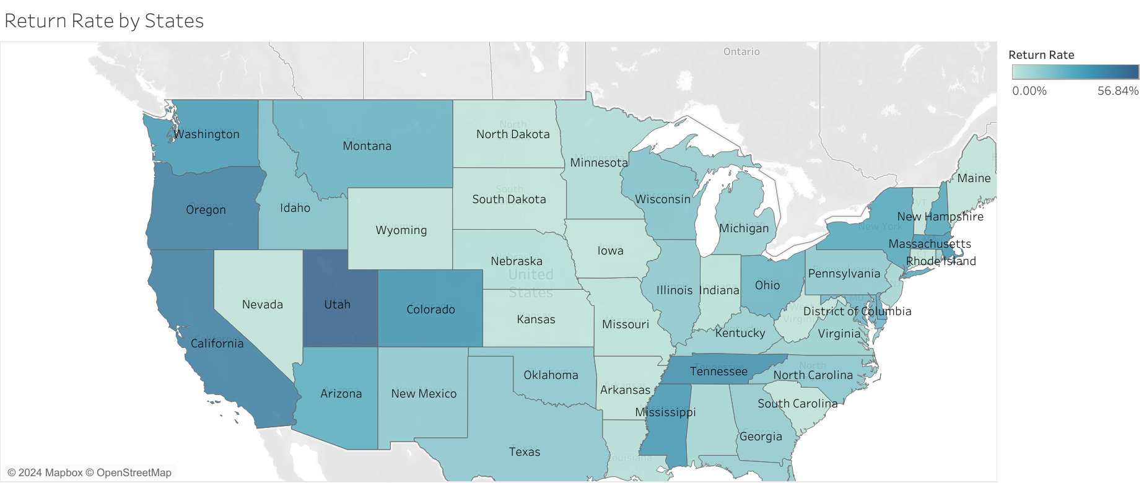

Slide 7
